Slide 1
Consumers, Producers, and the Efficiency of Markets

Slide 2
REVISITING THE MARKET EQUILIBRIUM
Do the equilibrium price and quantity maximize the total welfare of buyers and sellers?
Market equilibrium reflects the way markets allocate scarce resources.
Whether the market allocation is desirable can be addressed by welfare economics.

Slide 3
Welfare Economics
Welfare economics is the study of how the allocation of resources affects economic well-being.
Buyers and sellers receive benefits from taking part in the market.
The equilibrium in a market maximizes the total welfare of buyers and sellers.

Slide 4
CONSUMER SURPLUS
Willingness to pay is the maximum amount that a buyer will pay for a good.
It measures how much the buyer values the good or service.

Slide 5
CONSUMER SURPLUS
Consumer surplus is the buyer’s willingness to pay for a good minus the amount the buyer actually pays for it.

Slide 6

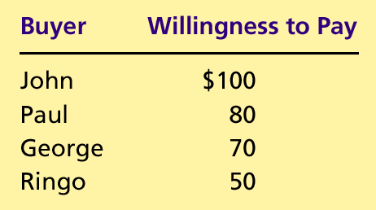
Table 1 Four Possible Buyers’ Willingness to Pay
Copyright©2004 South-Western

Slide 7
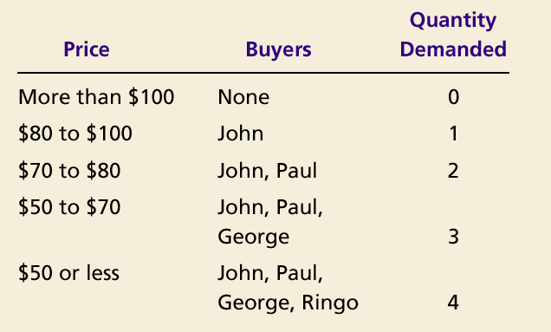
The Demand Schedule and the Demand Curve

Slide 8

Figure 1 The Demand Schedule and the Demand Curve
Price of
T-Shirt
$100
John
’
s willingness to pay
80
Paul
’
s willingness to pay
70
George
’
s willingness to pay
50
Ringo
’
s willingness to pay
Demand
0
1
2
3
4
Quantity of
T-Shirt
Copyright©2003 Southwestern/Thomson Learning

Slide 9
Figure 2 Measuring Consumer Surplus with the Demand Curve
(a) Price = $80
Price of
Album
$100
John
’
s consumer surplus ($20)
80
70
50
Demand
0
1
2
3
4
Quantity of
Albums
Copyright©2003 Southwestern/Thomson Learning

Slide 10
Figure 2 Measuring Consumer Surplus with the Demand Curve
(b) Price = $70
Price of
Album
$100
John
’
s consumer surplus ($30)
80
Paul
’
s consumer
70
surplus ($10)
Total
50
consumer
surplus ($40)
Demand
0
1
2
3
4
Quantity of
Albums
Copyright©2003 Southwestern/Thomson Learning

Slide 11
Using the Demand Curve to Measure Consumer Surplus
The area below the demand curve and above the price measures the consumer surplus in the market.

Slide 12
Figure 3 How the Price Affects Consumer Surplus
(a) Consumer Surplus at Price
P
Price
A
Consumer
surplus
P₁
B
C
Demand
0
Q₁
Quantity
Copyright©2003 Southwestern/Thomson Learning

Slide 13
Figure 3 How the Price Affects Consumer Surplus
(b) Consumer Surplus at Price
P
Price
A
Initial
consumer
surplus
P₁
C
Consumer surplus
B
to new consumers
P₂
F
D
E
Additional consumer
Demand
surplus to initial
consumers
0
Q₁
Q₂
Quantity
Copyright©2003 Southwestern/Thomson Learning

Slide 14
What Does Consumer Surplus Measure?
Consumer surplus, the amount that buyers are willing to pay for a good minus the amount they actually pay for it, measures the benefit that buyers receive from a good as the buyers themselves perceive it.

Slide 15
PRODUCER SURPLUS
Producer surplus is the amount a seller is paid for a good minus the seller’s cost.
It measures the benefit to sellers participating in a market.

Slide 16
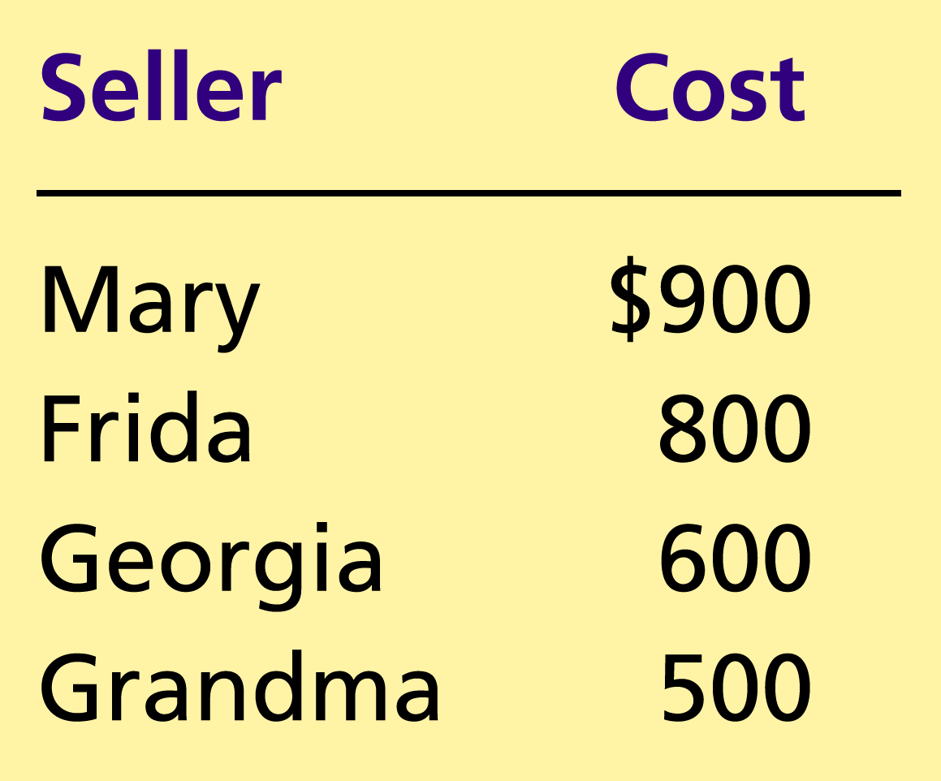
Table 2 The Costs of Four Possible Sellers
Copyright©2004 South-Western

Slide 17
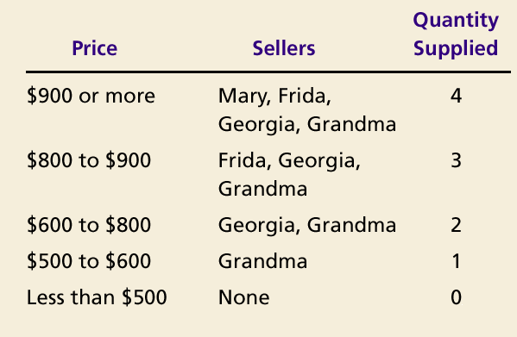
The Supply Schedule and the Supply Curve

Slide 18
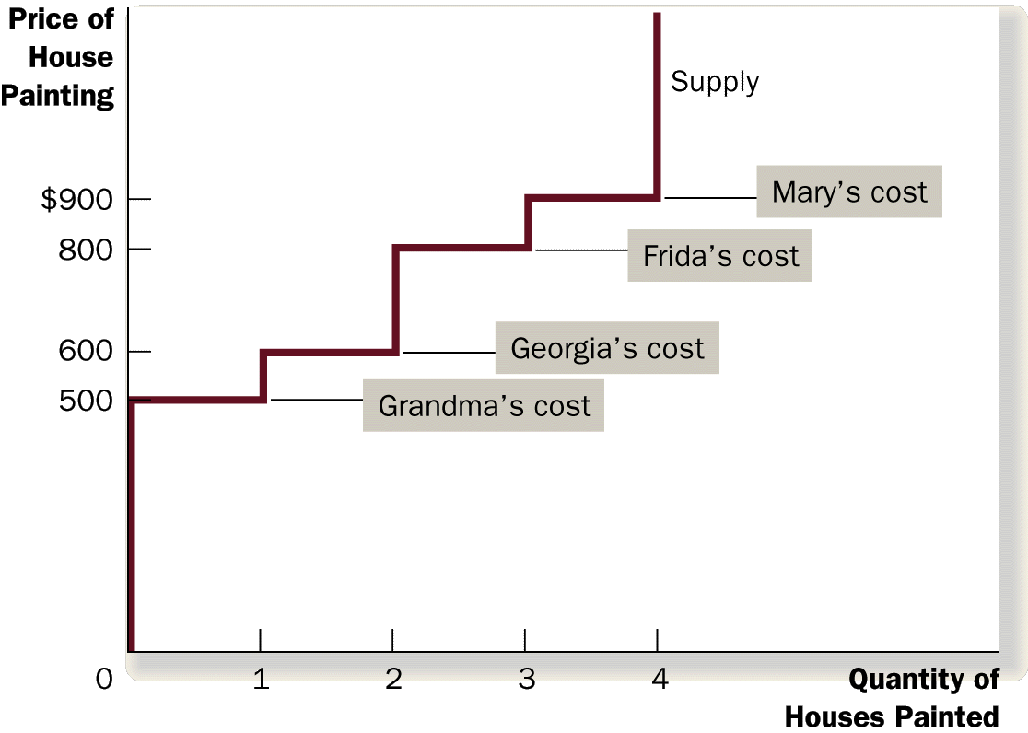
Figure 4 The Supply Schedule and the Supply Curve

Slide 19
Figure 5 Measuring Producer Surplus with the Supply Curve
(a) Price = $600
Price of
House
Painting
Supply
$900
800
600
500
Grandma
’
s producer
surplus ($100)
0
1
2
3
4
Quantity of
Houses Painted
Copyright©2003 Southwestern/Thomson Learning

Slide 20
Figure 5 Measuring Producer Surplus with the Supply Curve
(b) Price = $800
Price of
House
Painting
Supply
Total
producer
$900
surplus ($500)
800
600
Georgia
’
s producer
500
surplus ($200)
Grandma
’
s producer
surplus ($300)
0
1
2
3
4
Quantity of
Houses Painted
Copyright©2003 Southwestern/Thomson Learning

Slide 21
Figure 6 How the Price Affects Producer Surplus
(a) Producer Surplus at Price
P
Price
Supply
P₁
B
C
Producer
surplus
A
0
Q₁
Quantity
Copyright©2003 Southwestern/Thomson Learning

Slide 22
Figure 6 How the Price Affects Producer Surplus
(b) Producer Surplus at Price
P
Price
Additional producer
Supply
surplus to initial
producers
D
E
P₂
F
P₁
B
Initial
C
Producer surplus
producer
to new producers
surplus
A
0
Q₁
Q₂
Quantity
Copyright©2003 Southwestern/Thomson Learning

Slide 23
MARKET EFFICIENCY
Consumer surplus and producer surplus may be used to address the following question:
  Is the allocation of resources determined by free markets in any way desirable?

Slide 24
MARKET EFFICIENCY
Consumer Surplus
= Value to buyers – Amount paid by buyers
and
Producer Surplus
= Amount received by sellers – Cost to sellers

Slide 25
MARKET EFFICIENCY
Total surplus
= Consumer surplus + Producer surplus
or
Total surplus
= Value to buyers – Cost to sellers

Slide 26
MARKET EFFICIENCY
Efficiency is the property of a resource allocation of maximizing the total surplus received by all members of society.

Slide 27
MARKET EFFICIENCY
In addition to market efficiency, a social planner might also care about equity – the fairness of the distribution of well-being among the various buyers and sellers.

Slide 28
Figure 7 Consumer and Producer Surplus in the Market Equilibrium
Price
A
D
Supply
Consumer
surplus
Equilibrium
E
price
Producer
surplus
Demand
B
C
0
Equilibrium
Quantity
quantity
Copyright©2003 Southwestern/Thomson Learning

Slide 29
MARKET EFFICIENCY
Three Insights Concerning Market Outcomes
  Free markets allocate the supply of goods to the buyers who value them most highly, as measured by their willingness to pay.
  Free markets allocate the demand for goods to the sellers who can produce them at least cost.
  Free markets produce the quantity of goods that maximizes the sum of consumer and producer surplus.

Slide 30
Figure 8 The Efficiency of the Equilibrium Quantity
Price
Supply
Value
Cost
to
to
buyers
sellers
Cost
Value
to
to
sellers
buyers
Demand
0
Equilibrium
Quantity
quantity
Value to buyers is greater
Value to buyers is less
than cost to sellers.
than cost to sellers.
Copyright©2003 Southwestern/Thomson Learning

Slide 31
Evaluating the Market Equilibrium
Because the equilibrium outcome is an efficient allocation of resources, the social planner can leave the market outcome as he/she finds it.
This policy of leaving well enough alone goes by the French expression laissez faire.

Slide 32
Evaluating the Market Equilibrium
Market Power
  If a market system is not perfectly competitive, market power may result.
    Market power is the ability to influence prices.
    Market power can cause markets to be inefficient because it keeps price and quantity from the equilibrium of supply and demand.

Slide 33
Evaluating the Market Equilibrium
Externalities
  created when a market outcome affects individuals other than buyers and sellers in that market.
  cause welfare in a market to depend on more than just the value to the buyers and cost to the sellers.
When buyers and sellers do not take externalities into account when deciding how much to consume and produce, the equilibrium in the market can be inefficient.

